Slide 1
4. [Lab1] Designing IMM Application using IONIC Template
Training Workshop for IONIC framework

Slide 2
Objectives
This tutorial shows the process of IMM guide app.
We will learn how to use Ionic template for faster and easier development.

Slide 3
Contents
4.1 Purchasing Ionic template
4.2 Designing IMM app using Template
4.3 Wireframe of our application

Slide 4
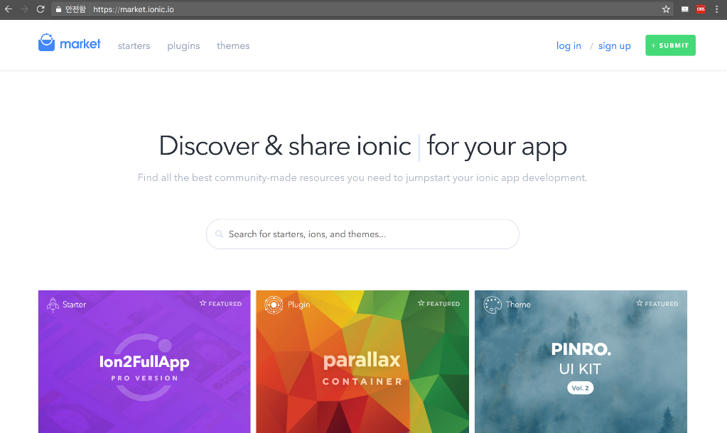
4.1 Purchasing Ionic template
Selecting template
You can search for template on Ionic market
https://market.ionic.ic

Slide 5
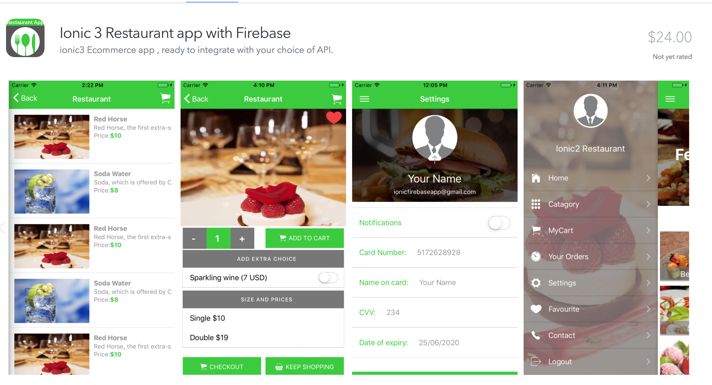
4.1 Purchasing Ionic template
Selecting template
Select a template that is appropriate for the app you want to implement.
Simulate a template by following steps.

Slide 6
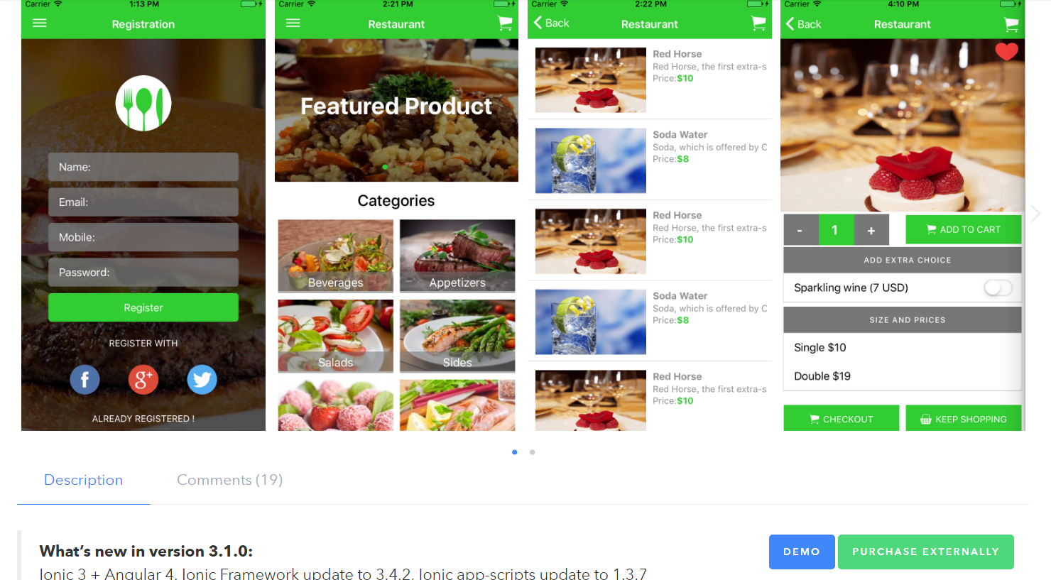

4.1 Purchasing Ionic template
Selecting template
Click DEMO
Click PRODUCT

Slide 7
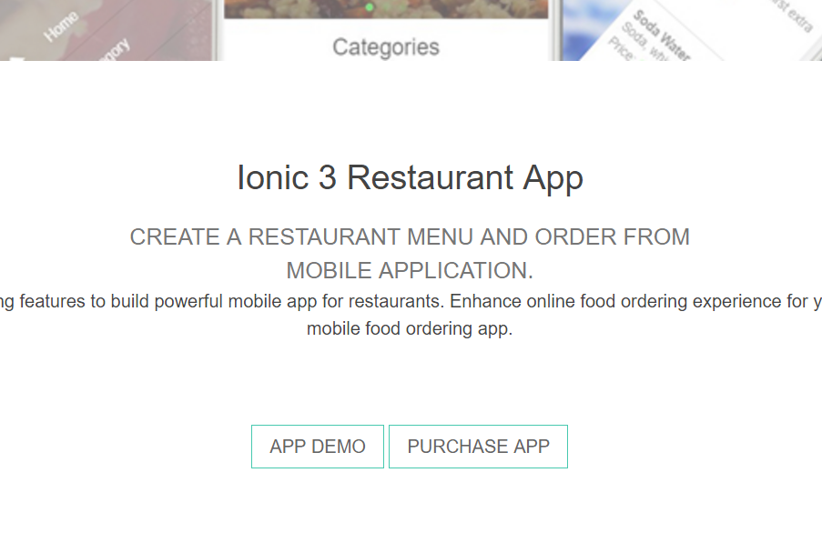
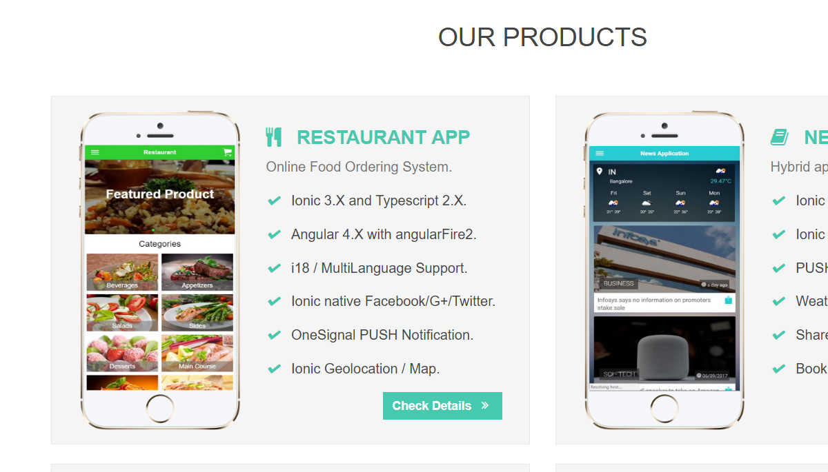
4.1 Purchasing Ionic template
Selecting template
3. Click Check Details
4. Click APP DEMO

Slide 8
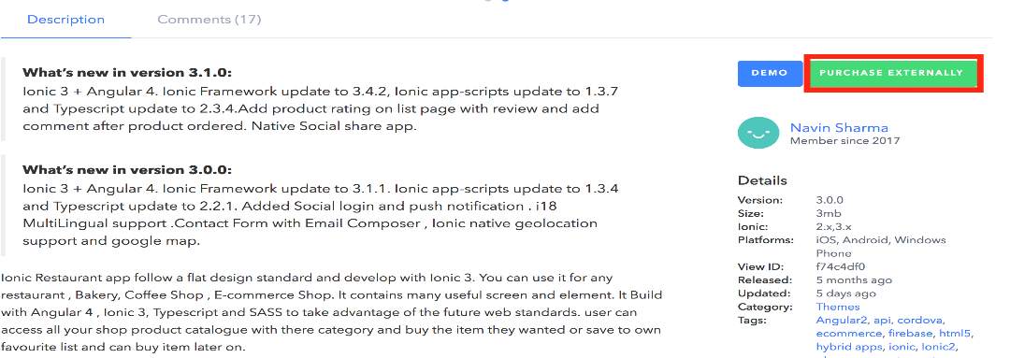
4.1 Purchasing Ionic template
Purchasing template
1. Click PRODUCT EXTERNALLY

Slide 9
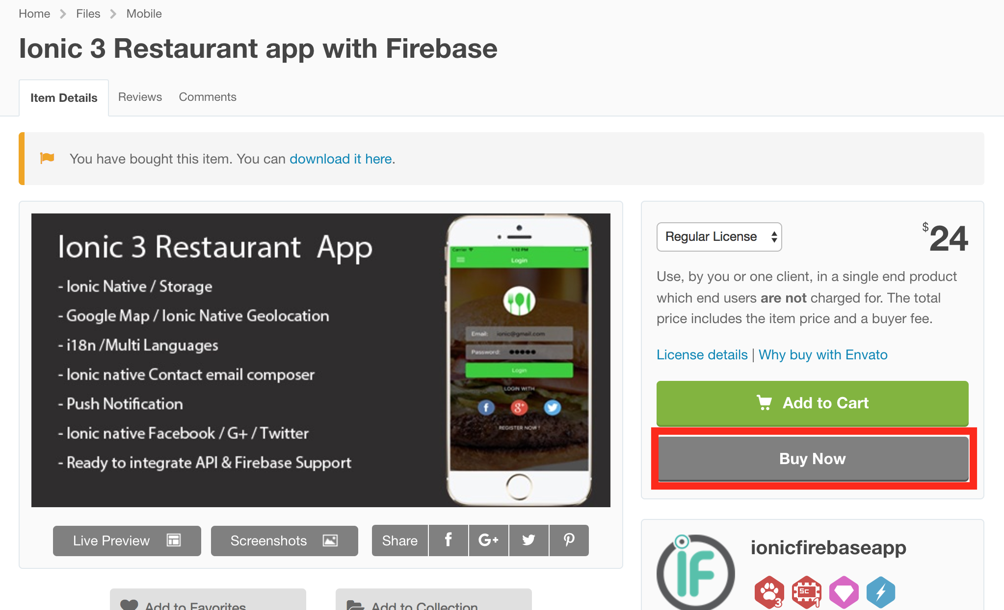
4.1 Purchasing Ionic template
Purchasing template
2. Click BUY NOW

Slide 10
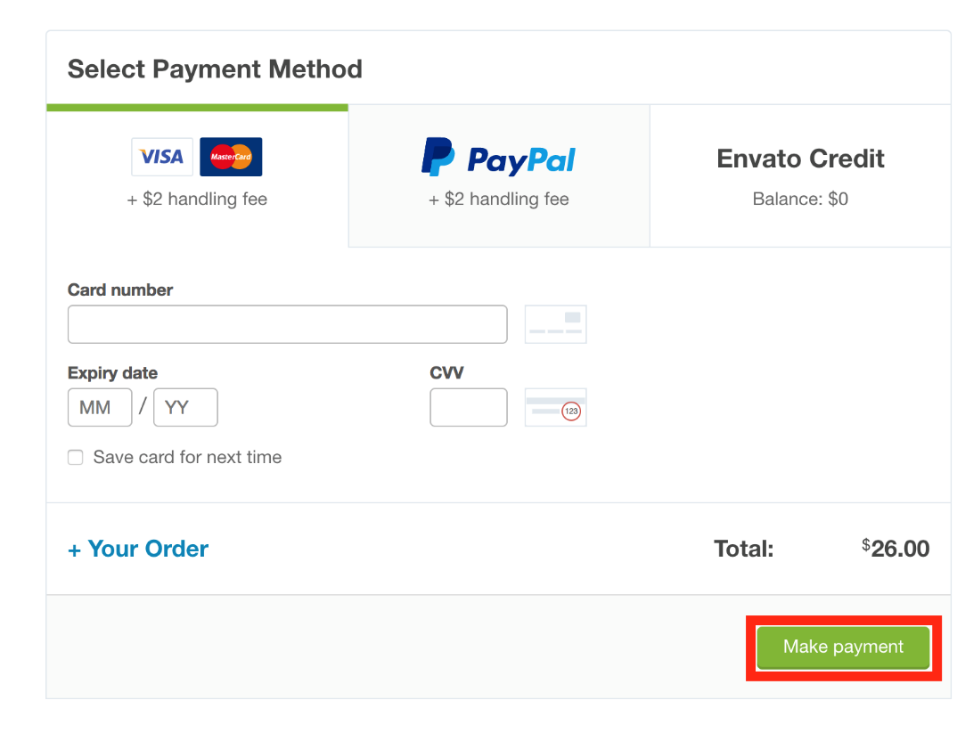
4.1 Purchasing Ionic template
Purchasing template
2. Write credit card information

Slide 11
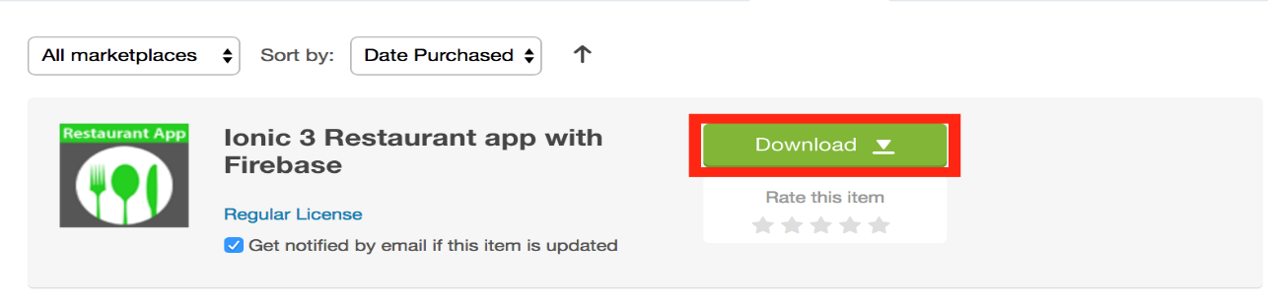
4.1 Purchasing Ionic template
Purchasing template
3. Click Download

Slide 12
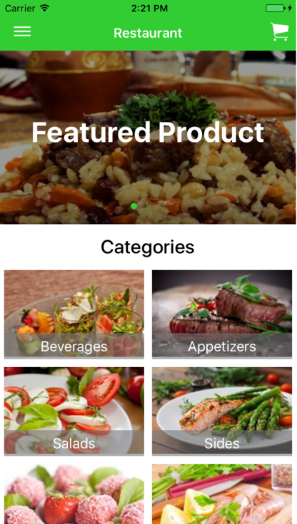
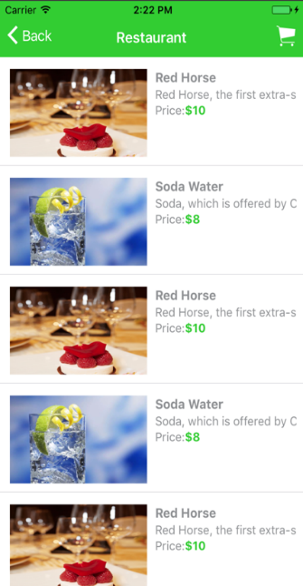
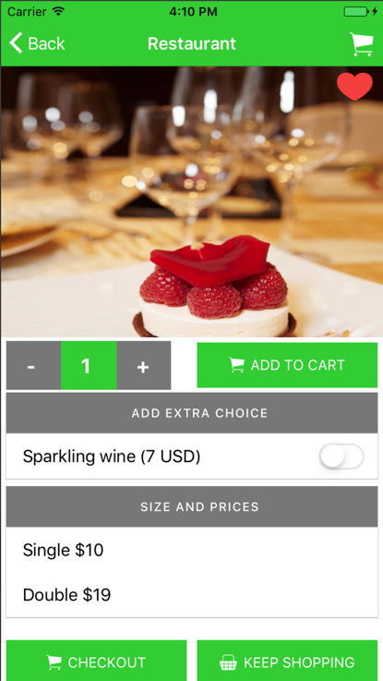
4.2 Designing IMM app using Template
Modifying wireframe of Ionic template
This is the process for designing wireframe based on Ionic template.
1. Capture template design

Slide 13
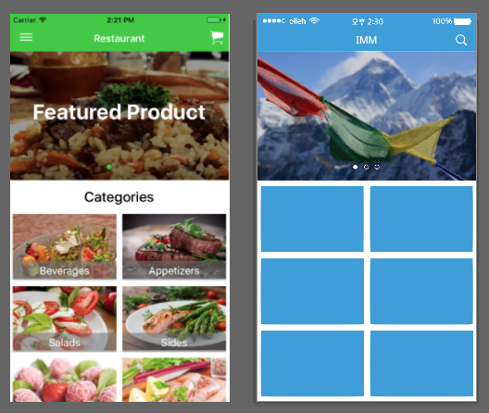
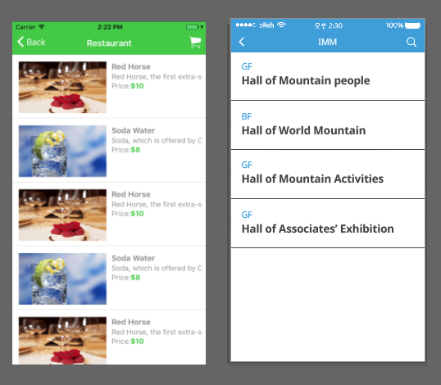
4.2 Designing IMM app using Template
Modifying wireframe of Ionic template
2. Editing design based on captured screens.
(Ex. color, font, etc)

Slide 14
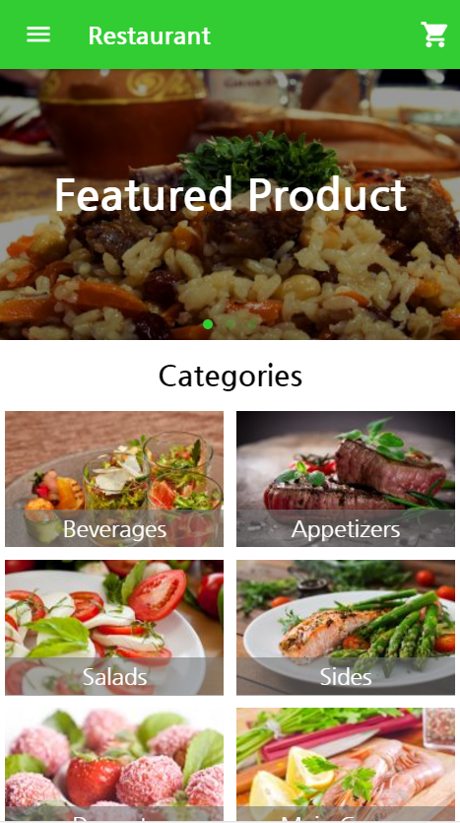



4.2 Designing IMM app using Template
Application Wireframe Example

Slide 15
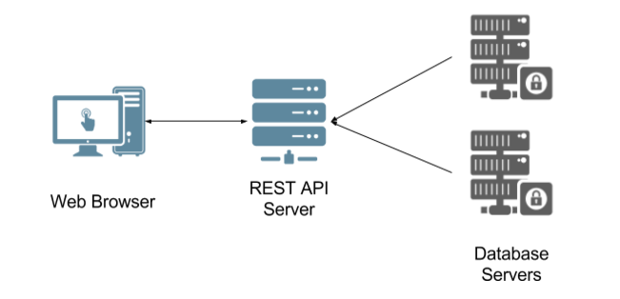

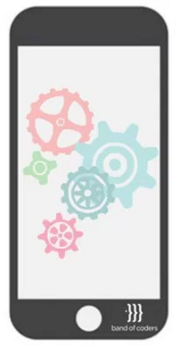
4.3 Wireframe of our application
Contents Arrangement of Application
Organize contents for creating API.
For constructing each page, app should request data from server.
Data
request
response
Application
Source: http://bandofcoders.com/blog/the-api-sever/

Slide 16


4.3 Wireframe of our application
Contents Arrangement of Application
Home Page
About museum Page
- Main images
museum image
information of museum

Slide 17

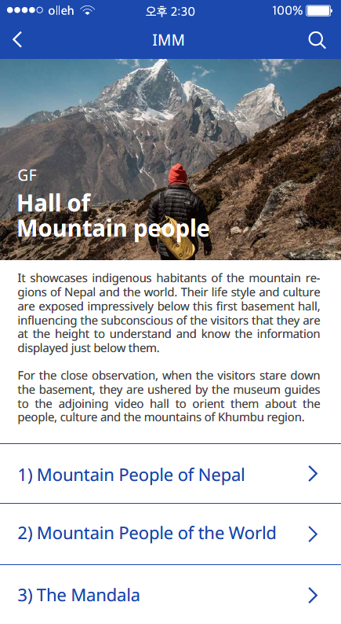
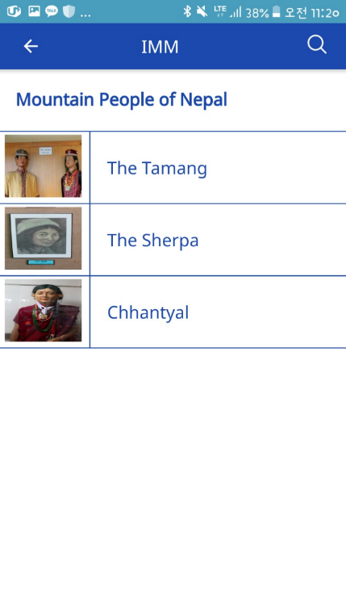
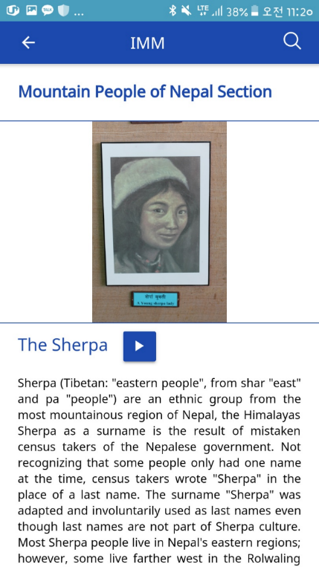
4.3 Wireframe of our application
Contents Arrangement of Application
Exhibition Page
Category Page
Section Page
Item Page
sum nail images
name of exhibition halls
location of halls
location of hall
name of hall
description
section list
section name
sum nail image of item
item name
section name
item image, name, description
video link

Slide 18
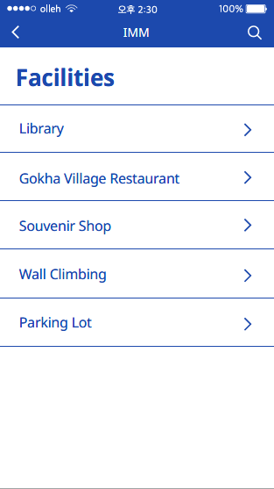
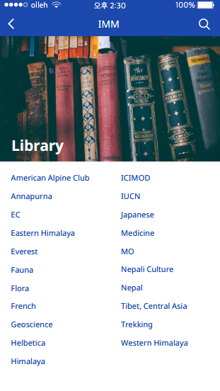
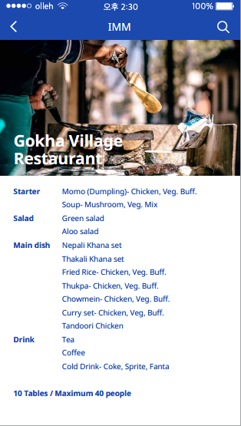
4.3 Wireframe of our application
Contents Arrangement of Application
Facility Page
Facility-library Page
Facility-gorkha Page
facility list
image
library list
image
category, contents
capability

Slide 19
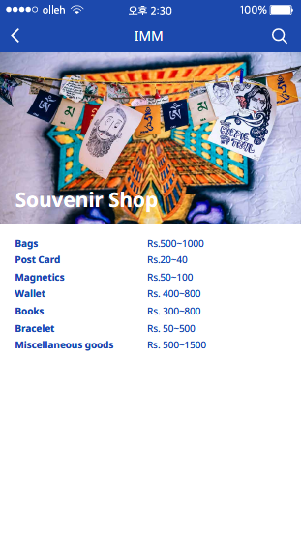
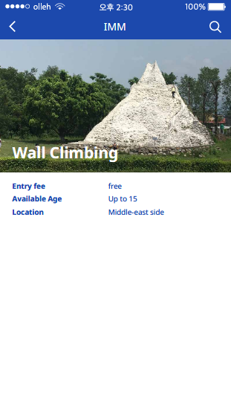
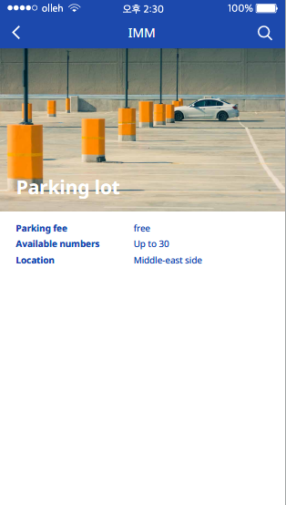
4.3 Wireframe of our application
Contents Arrangement of Application
Facility-detail Page
Facility-detail Page
Facility-detail Page
image
category, contents
image
category, contents
image
category, contents

Slide 20
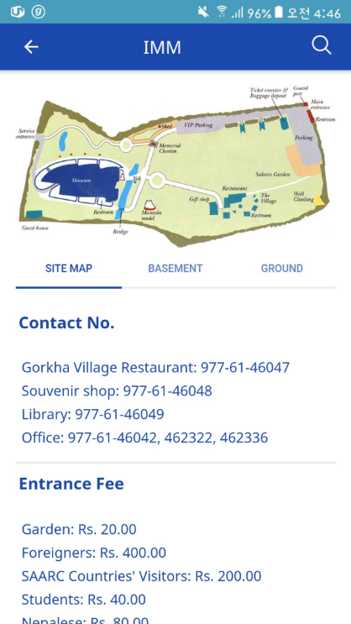
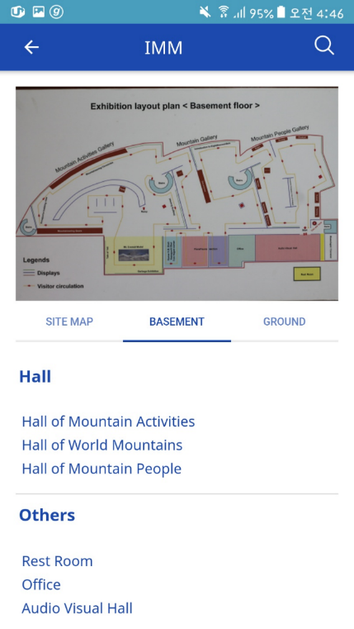
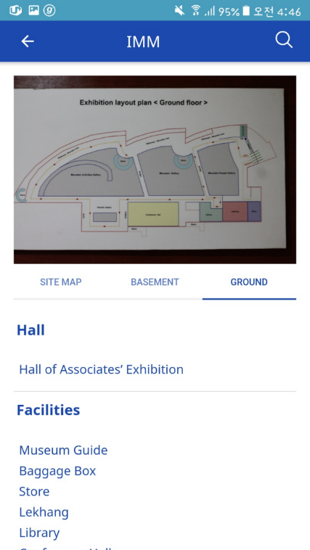
4.3 Wireframe of our application
Contents Arrangement of Application
Map Page
Map Page
Map Page
map image
information
map image
information
map image
information

